Slide 1


Intro to
Programming
With python
Last day
Monday, May 12 2025 TOH210
Notes:
Layout objects pulled from: https://slidesgo.com/
All icons are from: https://thenounproject.com/

Slide 2
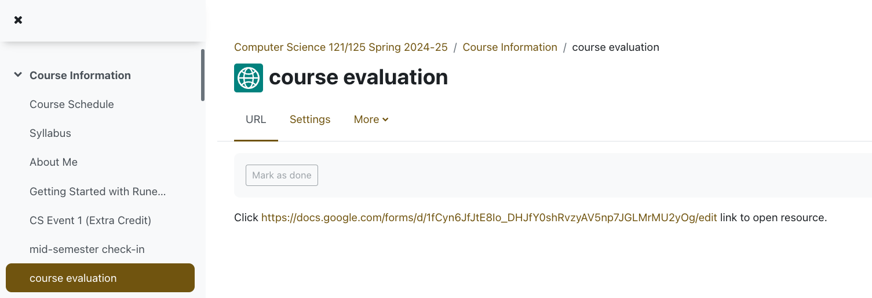
If 95% of students fill this out, I will bring treats in for our game day on Monday

Slide 3

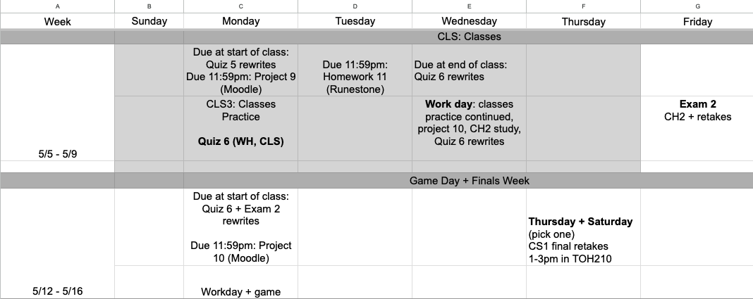
Last days of class
google sheet link
Come to office hours today if you have questions on Project 10 or want to check in about your grade in this course
Notes:
https://docs.google.com/forms/d/e/1FAIpQLSe3OloPAJSid4n6cyU_4qXpRWU7FOSmP7IVdRS_vh9cvYd9zQ/viewform?usp=sharing

Slide 4

before next time
Submit Project 10
Study for retakes if needed

